Slide 1



Capstone Project Phase B
24-1-D-40
Nitsan Maman
Ron Shahar
Advisor: PhD. Sulamy Moshe

Slide 2
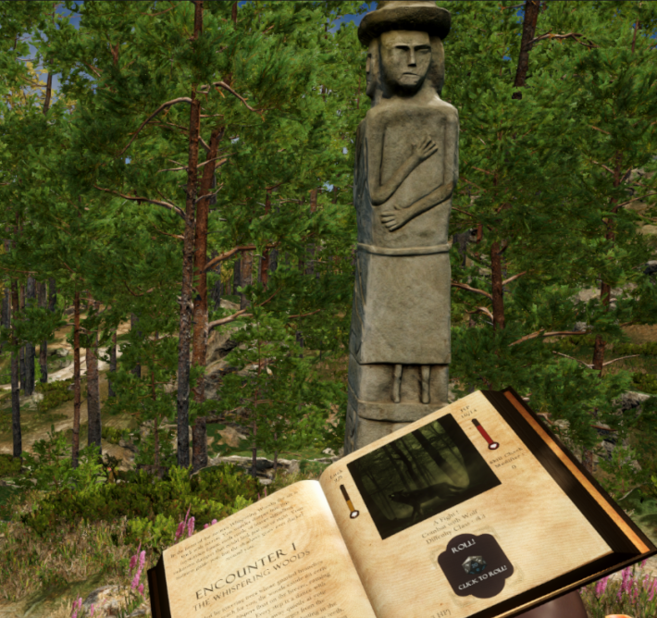
Introduction – What is TaleWeaver?
AI-Driven Dynamic Storytelling Game.
Personalized storytelling experiences.
Adaptive game world for better immersion.
An adventure set in the forest

Slide 3
The Problems
Decline in book reading.
Traditional Games often rely on fixed narratives. making replayability low once the story is complete.

Slide 4
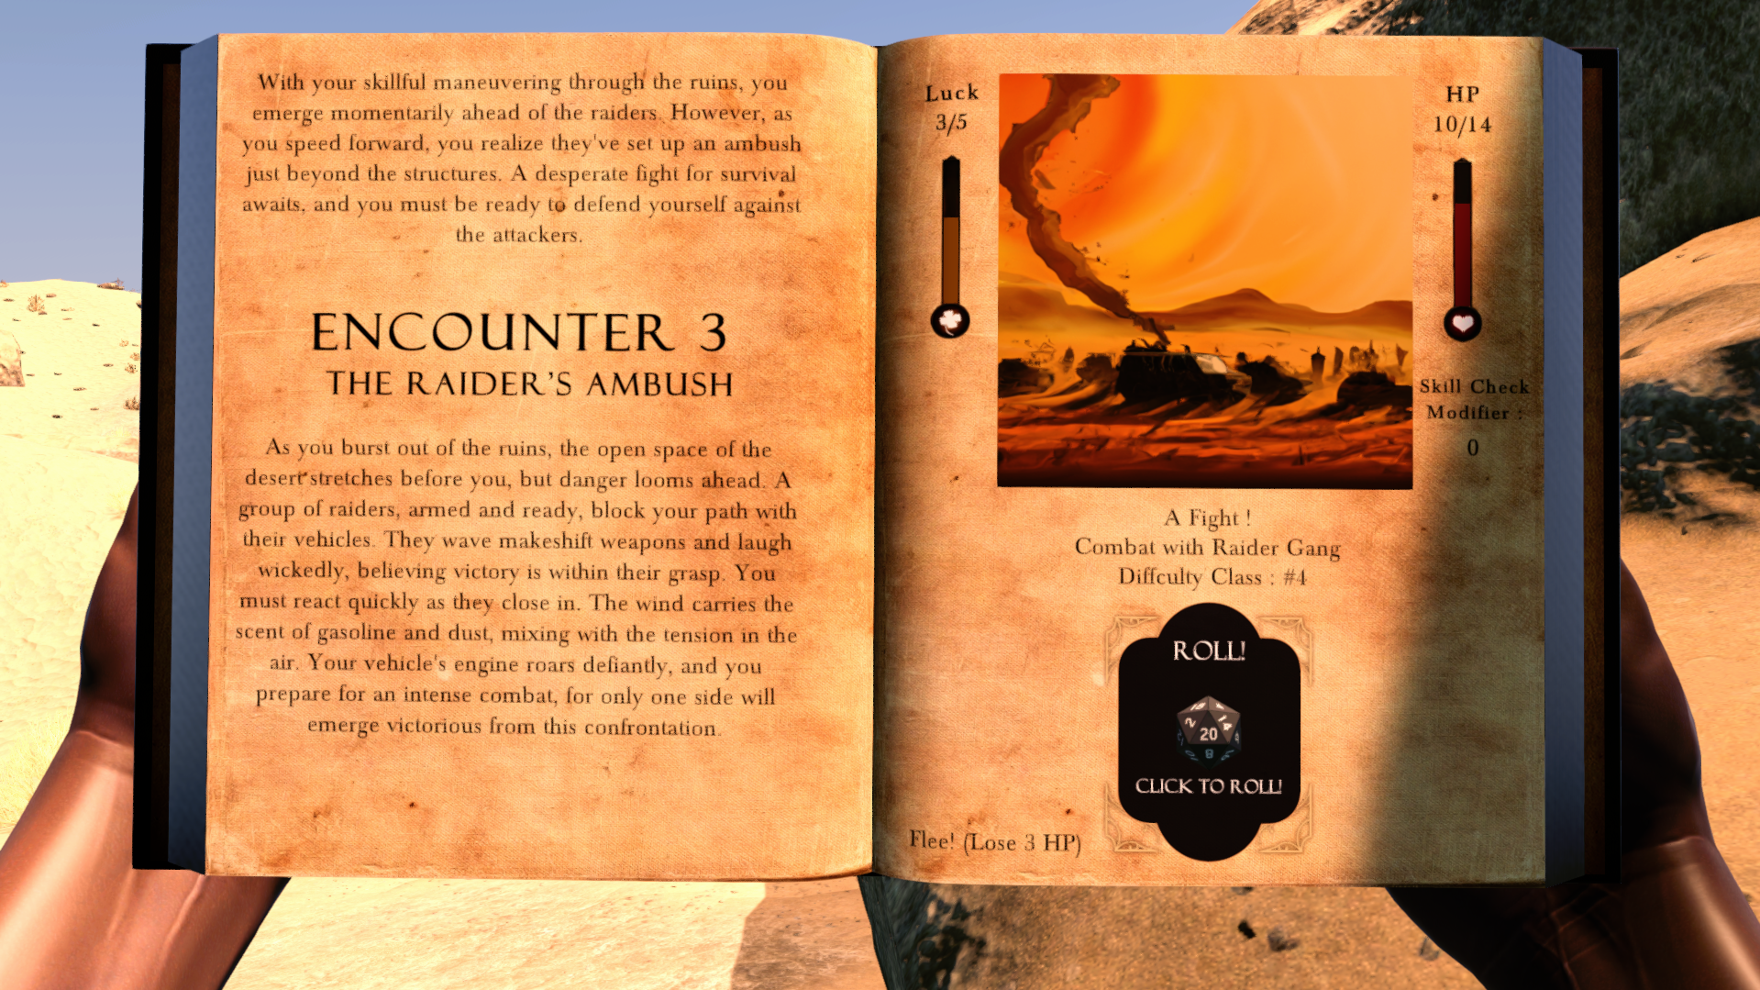
Our Approach
An Immersive game that allows players to actively shape their story.
An adventure set in the desert

Slide 5
Main System Requirements
Generate story adventures using AI
Six core gameplay mechanics to provide meaningful interaction with the AI-generated story.
Dynamic game world that change based on each page.

Slide 6
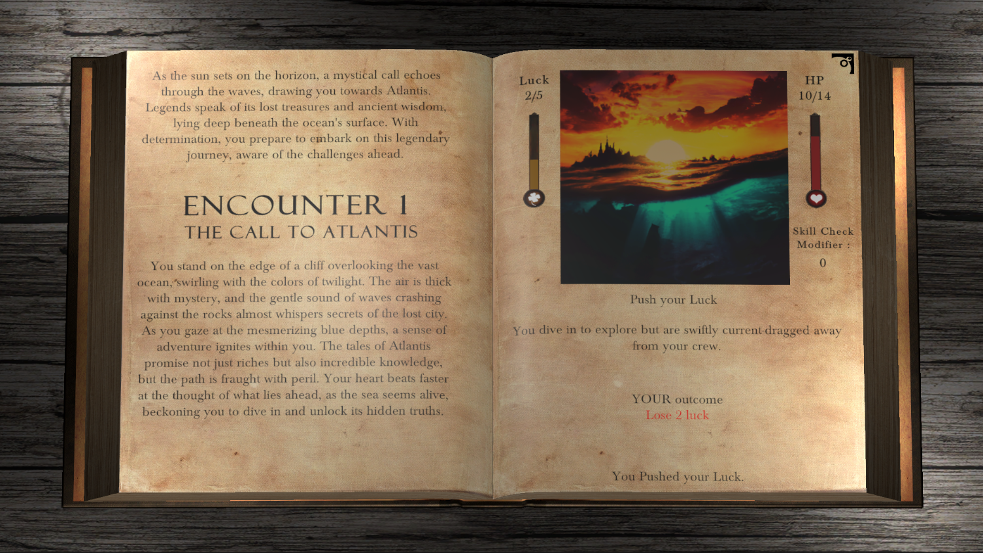
Technologies
Custom AI Model Integration
RAKE Keyword Extraction Algorithm
View Previous adventures screen

Slide 7
Custom AI Model Integration
Seamless interaction with gameplay mechanics.
AI generates structured outputs, guiding the game parser to recognize mechanics.
Ensures smooth transitions between story elements and gameplay.

Slide 8
Custom AI Model Integration
AI receives instructions detailing upcoming mechanics, including type, difficulty, and player status.
We predefine the gameplay loop, and the AI generates a story around it.
The game scripts integrates AI-generated content into gameplay, ensuring that the player actions drive the narrative and mechanics in a cohesive experience.

Slide 9
RAKE Algorithm
Extracts keywords from the AI-generated story.
Tailoring the game world environment.
Each page seamlessly transitions to the most immersive pre-made environment based on story elements.

Slide 10









Tools Used
Unity Game Engine
Visual Studio / NUnit
Git / Git LFS / GitHub
Postman / OpenAI Assistance Webpage
Photoshop / Unity Asset Store
Inno Setup

Slide 11
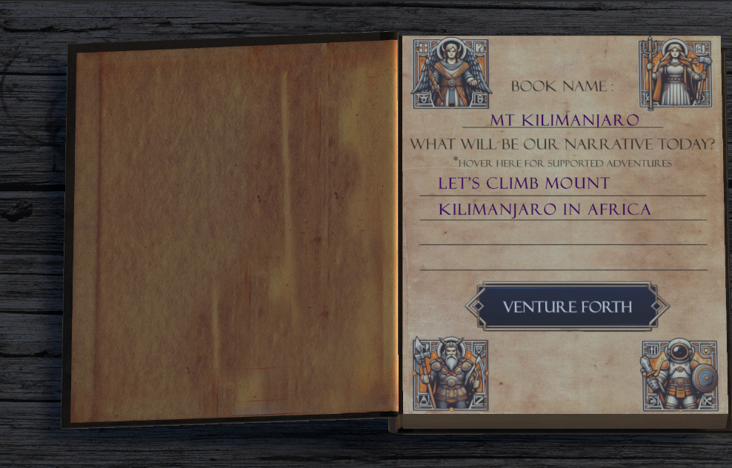
Challenges Faced
Data Management: Parsing JSON files from OpenAI API.
Book Animations: Achieving smooth page transitions.
UI Button Integration: Creating seamless fade-in/out buttons.
Create new adventure screen

Slide 12
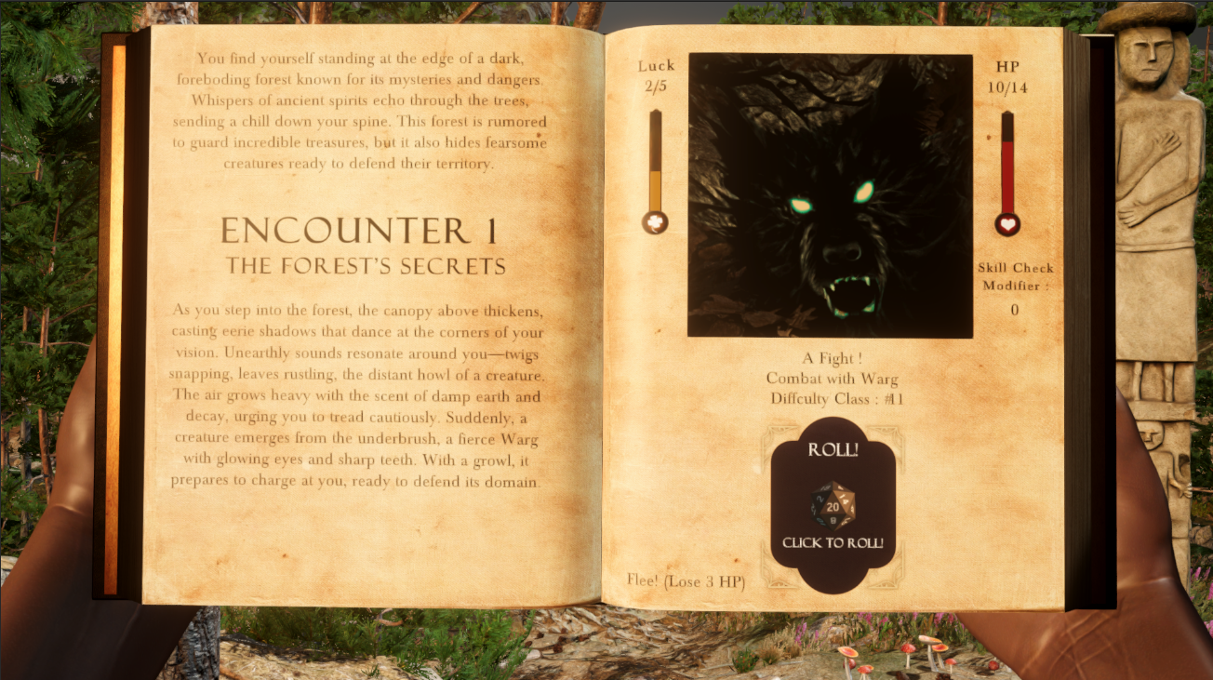
Challenges Faced
Expanding Gameplay Mechanics: Introducing varied mechanics like luck, roll, combat, choices.
API Costs: Saved generated content to reduce OpenAI API usage during testing.
AI Response Consistency: Developed intelligent parsing to ensure data reliability, Error Handler.
Combat Mechanic

Slide 13
Project Metrics - Achieved
AI Integration: We achieved seamless integration with OpenAI.
Gameplay Mechanics: We Successfully implemented six core mechanics.
Game Worlds / Scalability: Handles multiple locations and adventures, can be easily expanded.
Visual Design: We created a visually engaging interface.

Slide 14
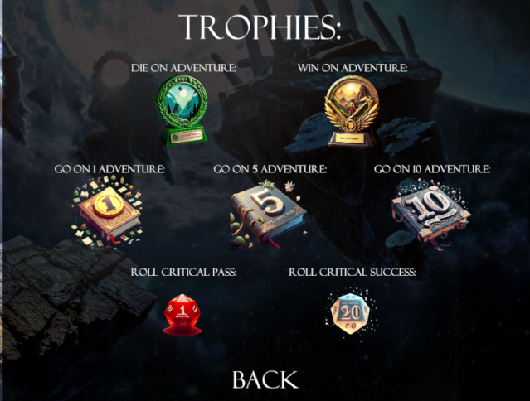
Project Metrics – Not Achieved
Sound Keywords: Sound wasn’t dynamically altered from extracted keywords.
Usability: Some users found the interface non-intuitive. (Added How to Play)
Reward System (Achieved due to Presentation Delay)

Slide 15
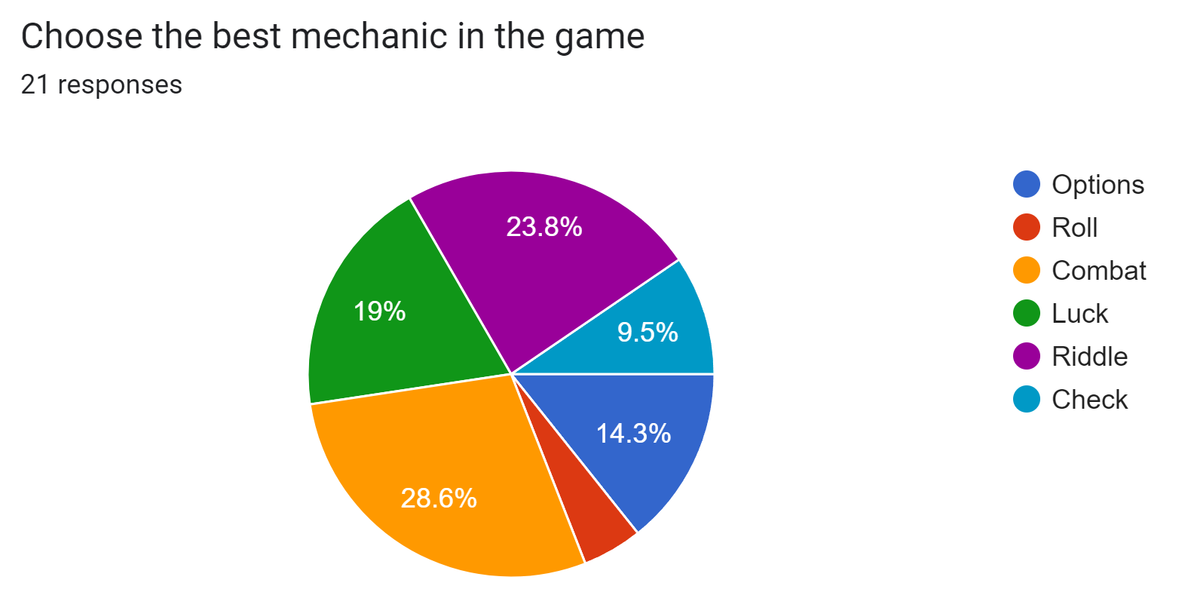
User Feedback
We let around 20 players to play our game prior to release.

Slide 16
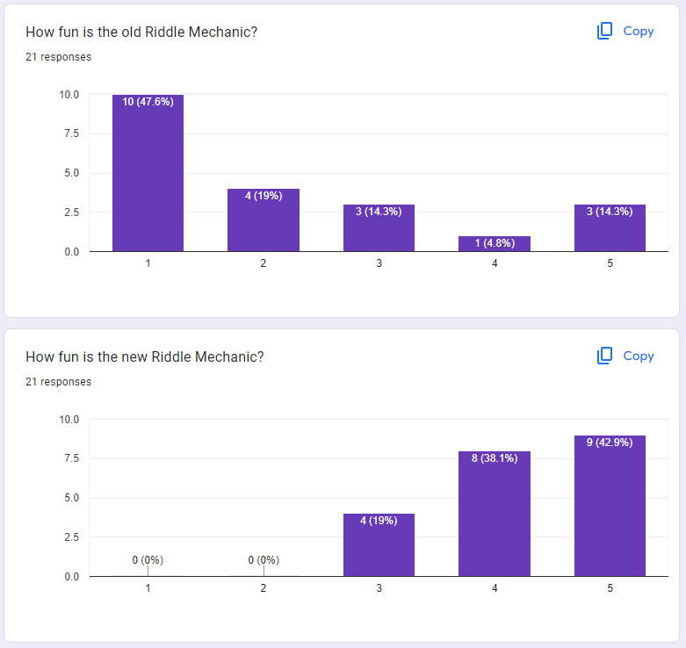
User Feedback
Problem: Riddle Mechanic became repetitive.
Rather than remove riddles, we added more variety and logic.

Slide 17
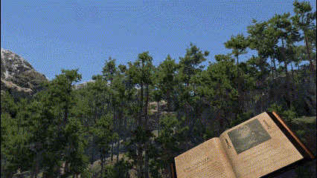
User Feedback
Problem: Some worlds did not match the weather and time of day of the story.
We add a weather / time of day system and let the player choose the time and weather.

Slide 18
Future Expansion
Open World Interactions: Expand content while waiting for new story pages to load.
AI generation: Faster AI generation will enhance gameplay flow and experience.
Adaptive Weather/Time of Day: adapt the weather and time of day according to the story.

Slide 19
Game Videos

Slide 20
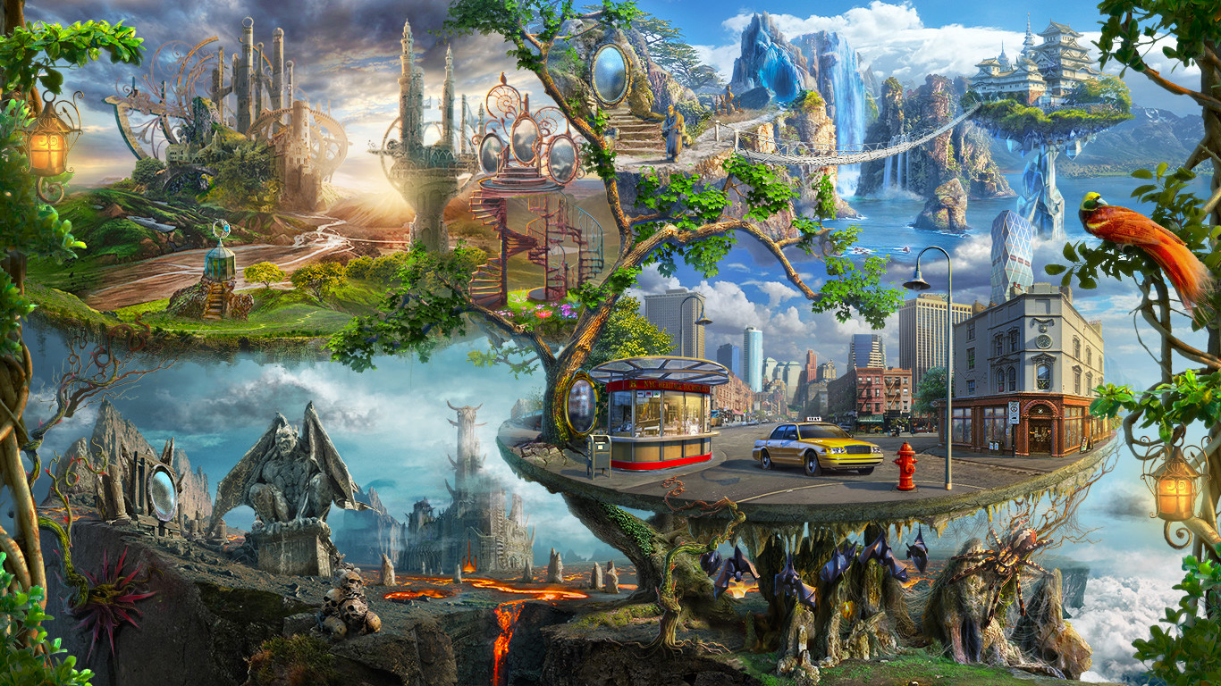

Slide 21
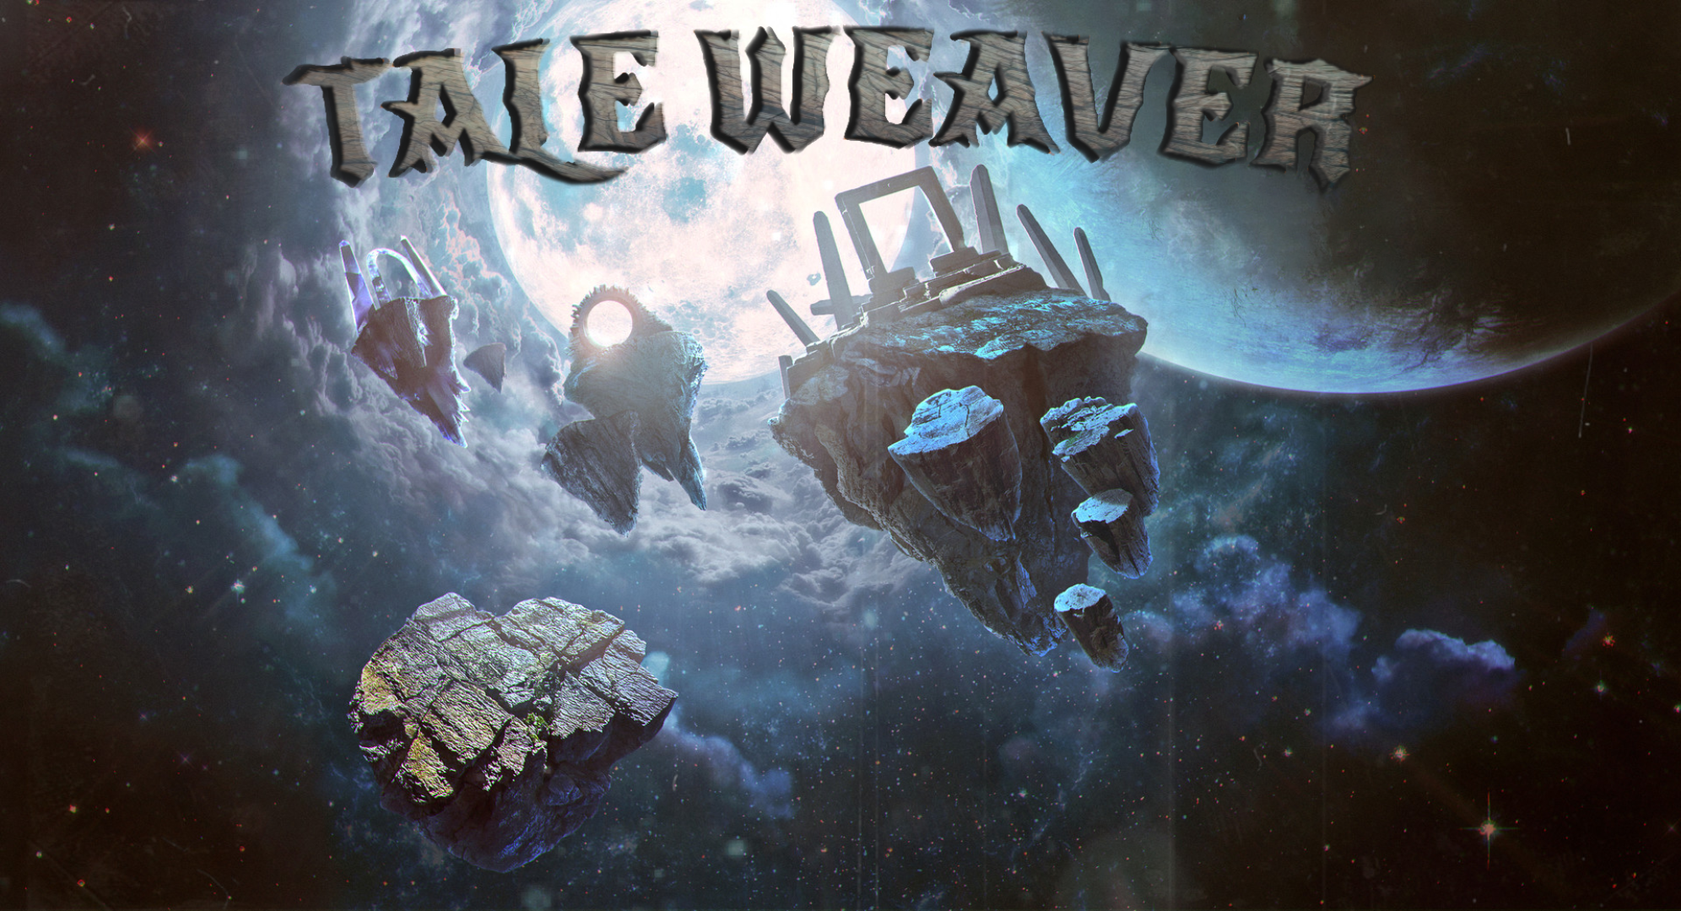

Slide 22
Live Demo

Slide 23

THANK YOU!
Any questions?

